Slide 1
Module 3: Software Development and Design
Instructor Materials
DevNet Associate v1.0
Notes:
Cisco Networking Academy Program
DevNet Associate v1.0
Module 3: Software Development and Design

Slide 2
Instructor Materials – Module 3 Planning Guide
This PowerPoint deck is divided in two parts:
Instructor Planning Guide
Information to help you become familiar with the module
Teaching aids
Instructor Class Presentation
Optional slides that you can use in the classroom
Begins on slide # 9
Note: Remove the Planning Guide from this presentation before sharing with anyone.
For additional help and resources go to the Instructor Home Page and Course Resources for this course. You also can visit the professional development site on www.netacad.com, the official Cisco Networking Academy Facebook page, or Instructor Only FB group.
Notes:
2

Slide 3
What to Expect in this Module
To facilitate learning, the following features within the GUI may be included in this module:
Feature | Description
Hands-On Labs | Labs designed for working with physical equipment.
Module Quizzes | Self-assessments that integrate concepts and skills learned throughout the series of topics presented in the module.
Module Summary | Briefly recaps module content.

Slide 4
Check Your Understanding
Check Your Understanding activities are designed to let students quickly determine if they understand the content and can proceed, or if they need to review.
Check Your Understanding activities do not affect student grades.
There are no separate slides for these activities in the PPT. They are listed in the notes area of the slide that appears before these activities.
Notes:
4

Slide 5
Module 3: Activities
What activities are associated with this module?
Page # | Activity Type | Activity Name | Optional?
3.1.12 | Lab | Explore Python Development Tools | Recommended
3.3.11 | Lab | Software Version Control with Git | Recommended
3.4.6 | Lab | Explore Python Classes | Recommended
3.5.7 | Lab | Create a Python Unit Test | Recommended
3.6.6 | Lab | Parse Different Data Types with Python | Recommended
Notes:
5

Slide 6
Module 3: Best Practices
Prior to teaching Module 3, the instructor should:
Review the activities and assessments for this module.
Try to include as many questions as possible to keep students engaged during classroom presentation.
Topic 3.1
Ask the learners what they understand of the term Software Development.
Probe if the learners have heard about the software development life cycle. Ask them to share their understanding with the class.
Discuss the various software development methodologies. Divide the class into groups and conduct a discussion on which methodology is the best in today’s Software Development scenario.
Notes:
6

Slide 7
Module 3: Best Practices (Contd.)
Topic 3.2
Ask the learners to refer to the book “Design Patterns - Elements of Reusable Object-Oriented Software” by the Gang of Four (GoF) to learn more on Software Design Patterns.
Provide the learners more insight into the two of the most commonly used design patterns: the Observer design pattern (a Behavioral design pattern), and Model-View-Controller (MVC).
Topic 3.3
Probe if the learners have heard about Version Control Systems. Discuss the subject in detail.
Discuss Git and GitHub.
Topic 3.4
Ask the learners to share their understanding of methods, functions, modules and classes.
Ask the learners what they understand of the term Clean Code? Prompt the learners to discuss and come up with reasons to why should developers write clean code.
Notes:
7

Slide 8
Module 3: Best Practices (Contd.)
Topic 3.5
Discuss the importance of reviewing code.
Discuss the different types of testing in detail.
Explain what is test driven development.
Topic 3.6
Discuss Data Formatting.
Ask the learners if they have heard of XML, JSON, and YAML. Ask them to share their knowledge on the topic.
Notes:
8

Slide 9
Module 3: Software Development and Design
DevNet Associate v1.0
Notes:
Cisco Networking Academy Program
DevNet Associates v1.0
Module 3: Software Development and Design
In-Session Activities / Explanations:
Time: 5 mins.
Instructor Notes:
Start the session by mentioning that the module provides context for where software development is today, and talks about modern software development methods.
Read out the Objectives and briefly describe each.
Key Points: NA

Slide 10
Module Objectives
Module Title: Software Development and Design
Module Objective: Use software development and design best practices.
Topic Title | Topic Objective
Software Development | Compare software development methodologies.
Software Design Patterns | Describe the benefits of various software design patterns.
Version Control Systems | Implement software version control using GIT.
Coding Basics | Explain coding best practices.
Code Review and Testing | Use Python Unit Test to evaluate code.
Understanding Data Formats | Use Python to parse different messaging and data formats.
Notes:
10
DevNet Associate v1.0
3 – Software Development and Design
3.0 – Introduction
3.0.2 – What Will I Learn to Do in This Module?

Slide 11
3.1 Software Development
Notes:
Source:
3– Software Development and Design
3.1 – Software Development and Design
In-Session Activities / Explanations:
Time: 40 mins
Instructor Notes:
Explain the Software Development Life cycle and its phases.
Discuss the methodologies of Software Development.
At the end of the topic, encourage the learners to perform Hands-on Lab.
Key Points: Software Development Life Cycle (SDLC), Python Development Tools

Slide 12
Software Development and Design Introduction
The software development process is also known as the software development life cycle (SDLC).
SDLC is more than just coding and also includes gathering requirements, creating a proof of concept, testing, and fixing bugs.
Notes:
3 – Software Development and Design
3.1 – Software Development
3.1.1 – Introduction

Slide 13
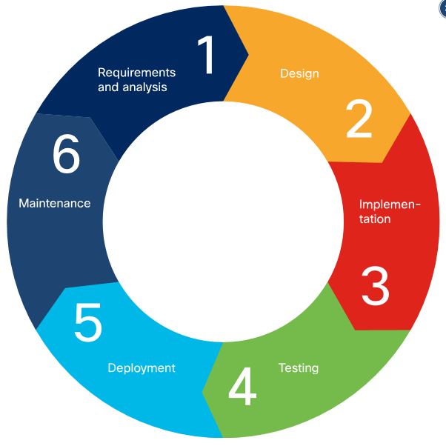
Software Development and Design Software Development Life Cycle (SDLC)
SDLC is the process of developing software, starting from an idea and ending with delivery. This process consists of six phases. Each phase takes input from the results of the previous phase.
SDLC is the process of developing software, starting from an idea and ending with delivery. This process consists of six phases. Each phase takes input from the results of the previous phase.
Although the waterfall methods is still widely used today, it's gradually being superseded by more adaptive, flexible methods that produce better software, faster, with less pain. These methods are collectively known as “Agile development.”
Notes:
3– Software Development and Design
3.1 – Software Development
3.1.2 – Software Development Life Cycle (SDLC)

Slide 14
Software Development and Design Requirements and Analysis Phase
The requirements and analysis phase involves exploring the stakeholders' current situation, needs and constraints, present infrastructure, and so on, and determining the problem to be solved by the software.
After gathering the requirements, the team analyzes the results to determine the following:
Is it possible to develop the software according to these requirements, and can it be done on-budget?
Are there any risks to the development schedule, and if so, what are they?
How will the software be tested?
When and how will the software be delivered?
At the conclusion of this phase, the classic waterfall method suggests creating a Software Requirement Specification (SRS) document, which states the software requirements and scope, and confirms this meticulously with stakeholders.
Notes:
3– Software Development and Design
3.1 – Software Development
3.1.3 – Requirements and Analysis Phase

Slide 15
Software Development and Design Design and Implementation Phases
Design
During the Design phase, the software architects and developers design the software based on the provided SRS.
At the end of the phase, the team creates High-Level Design (HLD) and Low-Level Design (LLD) documents.
Implementation
The implementation phase is also called the coding or development phase.
As all the components and modules are built during this phase, it is the longest phase of the life cycle.
At the end of the phase, the functional code that implements all customer's requirements is ready to be tested.
Notes:
3– Software Development and Design
3.1 – Software Development
3.1.4 – Design and Implementation Phases

Slide 16
Software Development and Design Testing, Deployment, and Maintenance Phases
Testing
In this phase, code is installed in the test environment
Functional testing, integration testing, performance testing and security testing is performed.
Testing continues until all the codes are bug free and pass all the tests. At the end of this phase, a high quality, bug-free, working piece of software is ready for production.
Deployment
During this phase, the software is installed into the production environment.
At the end of the phase, the product manager releases the final piece of software to end users.
Maintenance
During the maintenance phase, the team:
Provides support to customers
Fixes bugs found in production
Works on software improvements
Gathers new requests from the customer
At the end, the team works on the next iteration and version of the software.
Notes:
3– Software Development and Design
3.1 – Software Development
3.1.5 – Testing, Deployment, and Maintenance Phases

Slide 17
Software Development and Design Software Development Methodologies
A software development methodology is also known as Software Development Life Cycle model.
The three most popular methodologies are:
Waterfall
Agile
Lean
The type of methodology to be used depends on the:
Type of the project
Length of the project
Size of the team.
Notes:
3– Software Development and Design
3.1 – Software Development
3.1.6 – Software Development Methodologies

Slide 18
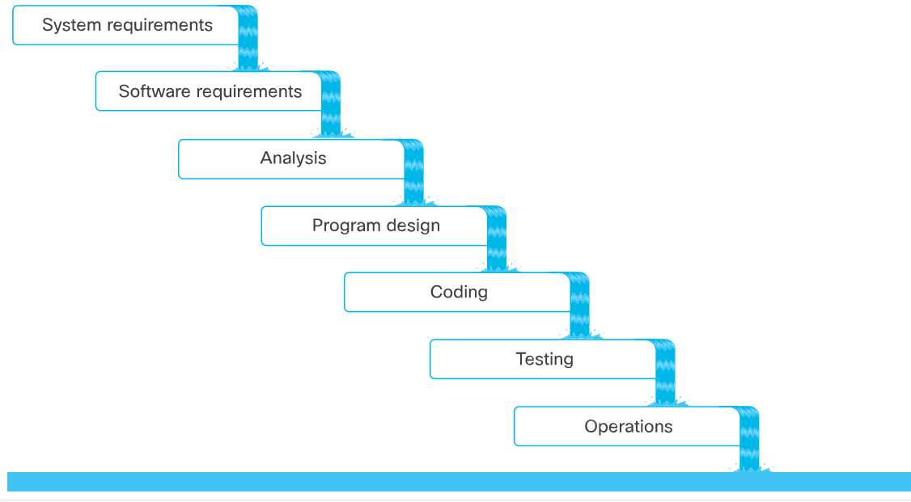
Software Development and Design Waterfall Software Development
The original waterfall model was created by Winston W. Royce.
His original model consisted of seven phases:
Notes:
3– Software Development and Design
3.1 – Software Development
3.1.7 – Waterfall Software Development

Slide 19
Software Development and Design Agile Software Development
Agile method is flexible and customer-focused.
A group of 17 software developers came up with the Manifesto for Agile Software Development, also known as the Agile Manifesto, in 2001. According to the Agile Manifesto, the values of Agile are:
Individuals and interactions over processes and tools
Working software over comprehensive documentation
Customer collaboration over contract negotiation
Responding to change over following a plan
The Agile manifesto lists 12 different principles:
Agile Manifesto Principles
Customer focus | Collaboration | Working software | Simplicity
Embrace change and adapt | Motivated teams | Work at a sustainable pace | Self-organizing teams
Frequent delivery of working software | Face-to-face conversations | Agile environment | Continuous Improvement
Notes:
3– Software Development and Design
3.1 – Software Development
3.1.8 – Agile Software Development

Slide 20
Software Development and Design Agile Methods
The popular Agile methods are:
Agile Scrum: The Scrum focuses on small, self-organizing teams that meet daily for short periods and work in iterative sprints.
Lean: The Lean method emphasizes on elimination of wasted effort in planning and execution, and reduction of programmer cognitive load.
Extreme Programming (XP): XP deliberately addresses the specific kinds of quality-of-life issues faced by the software development teams.
Feature-Driven Development (FDD): FDD prescribes that software development should proceed in terms of an overall model, broken out, planned, designed, and built feature-by-feature.
Notes:
3– Software Development and Design
3.1 – Software Development
3.1.9 – Agile Methods

Slide 21
Software Development and Design Agile Methods (Contd.)
Sprints
A sprint is a specific period of time, usually between 2-4 weeks, during which, each team takes on as many tasks (also known as user stories) as they feel they can accomplish. When the sprint is over, the software should be working and deliverable.
The duration of the sprint is determined before the process begins and should rarely change.
Backlog
The backlog consists of all the features of the software, in a prioritized list.
User stories
A user story is a simple statement of what a user (or a role) needs, and why. Each user story should be small enough that a single team can finish it within a single sprint.
The suggested template for a user story is:
As a <user|role>, I would like to <action>, so that <value|benefit>
Notes:
3– Software Development and Design
3.1 – Software Development
3.1.9 – Agile Methods

Slide 22
Software Development and Design Agile Methods (Contd.)
Scrum Teams
Scrum teams are cross-functional, collaborative, self-managed and self-empowered.
The scrum teams should not be larger than 10 individuals.
The scrum master should have a daily stand-up meeting with the team at a fixed time everyday for not more than 15 minutes.
The goal is to go over important tasks that have been finished, are in progress, or are about to be started.
Notes:
3– Software Development and Design
3.1 – Software Development
3.1.9 – Agile Methods

Slide 23
Software Development and Design Lean Software Development
Lean software development is based on Lean Manufacturing principles, which are focused on minimizing waste and maximizing value to the customer.
The seven principles of lean, given in the book “Lean Software Development: An Agile Toolkit,” are as follows:
Eliminate waste
Amplify learning
Decide as late as possible
Deliver as fast as possible
Empower the team
Build integrity in
Optimize the whole
Notes:
3– Software Development and Design
3.1 – Software Development
3.1.10 – Lean Software Development

Slide 24
Software Development and Design Lean Software Development (Contd.)
Eliminate waste
It is the most fundamental lean principle.
There are seven wastes of software development:
Partially done work
Extra processes
Extra features
Task switching
Waiting
Motion
Defects
Notes:
3– Software Development and Design
3.1 – Software Development
3.1.10 – Lean Software Development

Slide 25
Software Development and Design Lean Software Development (Contd.)
Amplify Learning with Short Sprints
To be able to fine tune a software, there should be frequent short iterations of working software. This enables the following:
Developers learn faster
Customers can give feedback sooner
Features can be adjusted so that they bring customers more value
Decide as Late as Possible
When there is uncertainty, it is best to delay the decision-making until as late as possible in the process. This is because it is better to base decisions on facts rather than opinions or speculations.
Deliver as Fast as Possible
Deliver As Fast as Possible
Enables customers to provide feedback | Doesn't allow customers to change their mind
Enables developers to amplify learning | Makes everyone take decisions faster
Provides customers the required features | Produces less waste
Notes:
3– Software Development and Design
3.1 – Software Development
3.1.11 – Lean Software Development (Cont.)

Slide 26
Software Development and Design Lean Software Development (Contd.)
Empower the Team
Each person must be allowed to make decisions in the area of their own expertise.
Build Integrity In
Integrity for the software is when the software addresses the customer’s needs as well as maintains the usefulness for the customer.
Optimize the Whole
The software must be built cohesively. The value of the software will suffer if each expert only focuses on their expertise and doesn't consider the ramifications of their decisions on the rest of the software.
Notes:
3– Software Development and Design
3.1 – Software Development
3.1.11 – Lean Software Development (Cont.)

Slide 27
Software Development and Design Lab - Explore Python Development Tools
In this lab, you will complete the following objectives:​
Part 1: Launch the DEVASC VM
Part 2: Review the Python Installation
Part 3: PIP and Python Virtual Environments
Part 4: Sharing Your Virtual Environment
Notes:
3– Software Development and Design
3.1 – Software Development
3.1.12 – Lab - Explore Python Development Tools

Slide 28
3.2 Software Design Patterns
Notes:
Source:
3 – Software Development and Design
3.2 –Software Design Patterns
In-Session Activities / Explanations:
Time: 10 mins
Instructor Notes:
Discuss how Software Design Patterns speed up development.
Discuss the book on “Design Patterns”
Explain the execution pattern of the Observer Design Pattern and the Model-View-Controller.
Key Points: Software design patterns, Model-View-Controller (MVC)

Slide 29
Software Design Patterns Introduction
Software design patterns are best practice solutions for solving common problems in software development.
Design patterns are language-independent.
In 1994, Erich Gamma, Richard Helm, Ralph Johnson, and John Vlissides (known as the Gang of Four (GoF)) published a book called Design Patterns - Elements of Reusable Object-Oriented Software. Patterns identified are:
Program to an interface, not an implementation.
Favor object composition over class inheritance.
Software design patterns have already been proven to be successful, so using them can speed up development.
Notes:
3 – Software Development and Design
3.2 –Software Design Patterns
3.2.1 – Introduction

Slide 30
Software Design Patterns The Original Design Patterns
The Gang of Four divided patterns into three main categories:
Creational
Structural
Behavioral
They listed 23 design patterns.
Two of the most commonly used design patterns are:
The Observer design pattern (a Behavioral design pattern)
The Model-View-Controller (MVC)
Notes:
3 – Software Development and Design
3.2 –Software Design Patterns
3.2.2 – The Original Design Patterns

Slide 31
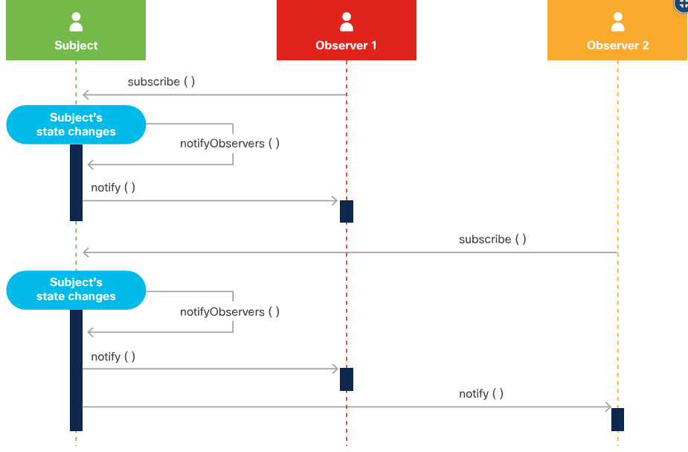
Software Design Patterns Observer Design Pattern
The observer design pattern is a subscription notification design that lets objects receive events when there are changes to an object they are observing.
To implement this subscription mechanism:
The subject must have the ability to store a list of all of its observers.
The subject must have methods to add and remove observers.
The benefit of the observer design pattern is that observers can get real time data from the subject when a change occurs.
Subscription mechanisms always provide better performance than other options, such as polling.
Notes:
3 – Software Development and Design
3.2 –Software Design Patterns
3.2.3 – Observer Design Pattern

Slide 32
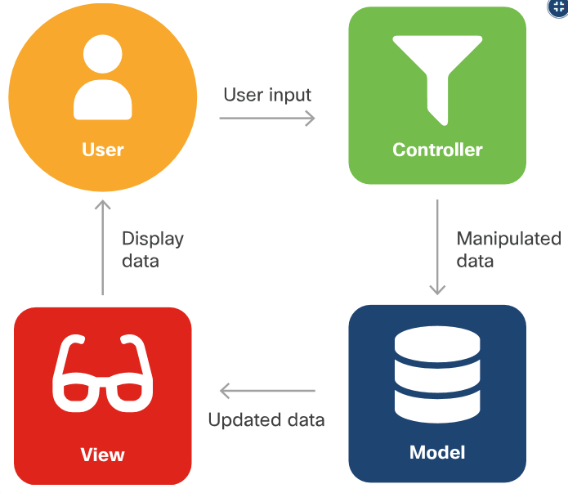
Software Design Patterns Model-View-Controller (MVC)
The Model-View-Controller (MVC) design pattern aims to simplify development of applications that depend on graphic user interfaces.
MVC abstracts code and responsibility into three different components:
Model: The model is the application's data structure and is responsible for managing the data, logic and rules of the application. It gets input from the controller.
View: The view is the visual representation of the data.
Controller: The controller is the middleman between the model and view. It takes in user input and manipulates it to fit the format for the model or view.
The benefit of MVC is that each component can be built in parallel.
Notes:
3 – Software Development and Design
3.2 –Software Design Patterns
3.2.4 – Model-View-Controller (MVC)

Slide 33
3.3 Version Control Systems
Notes:
Source:
3 – Software Development and Design
3.3 –Version Control Systems
In-Session Activities / Explanations:
Time: 20 mins
Instructor Notes:
Explain the benefits and types of Version Control Systems.
Discuss branching.
Discuss what is GitHub and how it is different from Git.
Explain the various Git commands with examples.
At the end of the topic, encourage the learners to perform the Hands-on Lab.
Key Points: Version Control Systems, Git, .diff files

Slide 34
Version Control Systems Types of Version Control Systems
Version control, also called version control systems, revision control or source control, is a way to manage changes to a set of files in order to keep a history of those changes.
Benefits of version control are:
Enables collaboration
Accountability and visibility
Work in isolation
Safety
Work anywhere
There are three types of version control systems:
Local
Centralized
Distributed
Notes:
3 – Software Development and Design
3.3 –Version Control Systems
3.3.1 – Types of Version Control Systems

Slide 35
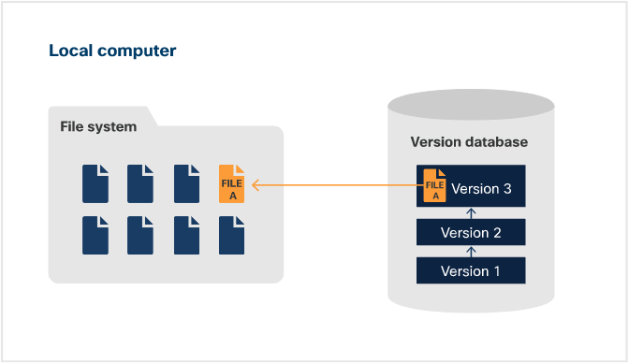
Version Control Systems Types of Version Control Systems (Contd.)
Local Version Control System (LVCS)
LVCS uses a simple database to keep track of all of the changes to the file.
In most cases, the system stores the delta between the two versions of the file.
When the user wants to revert to the file, the delta is reversed to get to the requested version.
Notes:
3 – Software Development and Design
3.3 –Version Control Systems
3.3.1 – Types of Version Control Systems

Slide 36
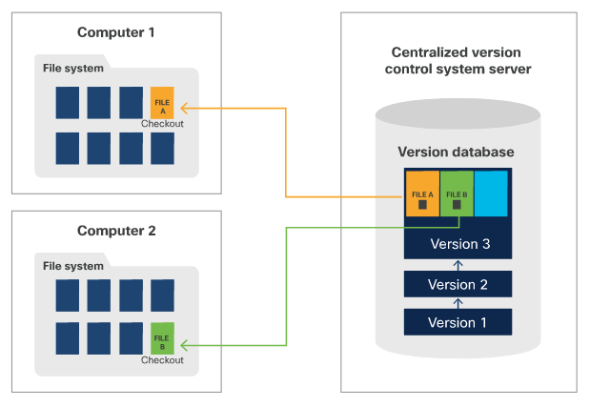
Version Control Systems Types of Version Control Systems (Contd.)
Centralized Version Control System (CVCS)
CVCS uses a server-client model.
The repository is stored in a centralized location, on a server.
In CVCS, only one individual can work on a particular file at a time.
An individual must check out the file to lock it and make the required changes and check in once done.
Notes:
3 – Software Development and Design
3.3 –Version Control Systems
3.3.1 – Types of Version Control Systems

Slide 37
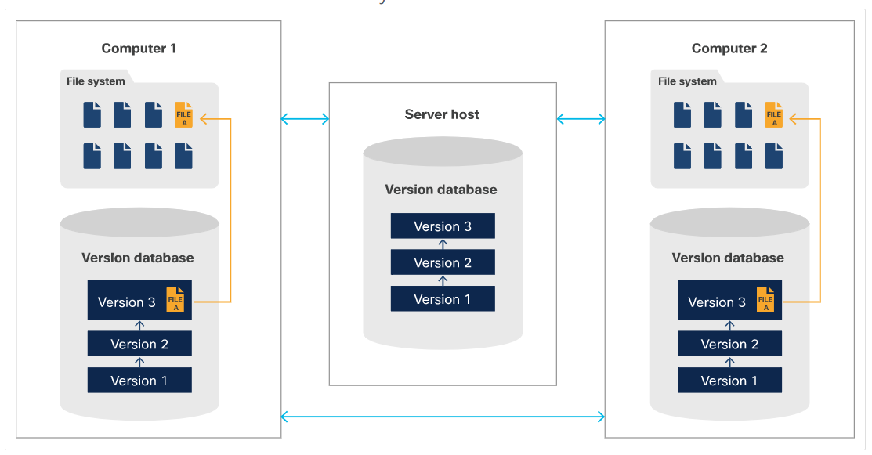
Version Control Systems Types of Version Control Systems (Contd.)
Distributed Version Control System (DVCS)
DVCS is a peer-to-peer model.
The repository can be stored on a client system, but it is usually stored in a repository hosting service.
In DVCS, every individual can work on any file, at the same time, because the local file in the working copy is being modified. Hence, locking is not required.
When the individual has made the changes, they push the file to the main repository that is in the repository hosting service, and the version control system detects any conflicts between file changes.
Notes:
3 – Software Development and Design
3.3 –Version Control Systems
3.3.1 – Types of Version Control Systems

Slide 38
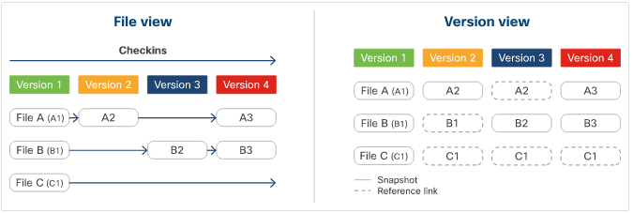
Version Control Systems Git
Git is an open source implementation of a distributed version control system that is currently the latest trend in software development.
A Git client must be installed on a client machine. It is available for MacOS, Windows, and Linux/Unix.
One key difference between Git and other version control systems is that Git stores data as snapshots instead of differences (the delta between the current file and the previous version).
If the file does not change, Git uses a reference link to the last snapshot in the system instead of taking a new and identical snapshot.
Notes:
3 – Software Development and Design
3.3 –Version Control Systems
3.3.2 – Git

Slide 39
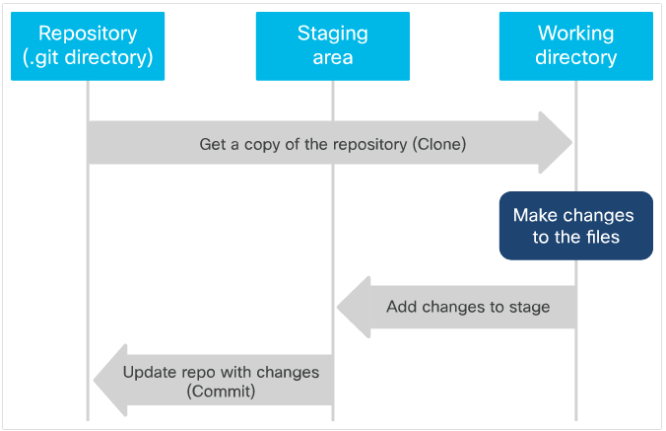
Version Control Systems Git (Contd.)
Git is organized by 3s- three stages and three states.
The three stages are:
Repository (the .git directory)
Working directory
Staging area
The three states are:
Committed
Modified
Staged
Notes:
3 – Software Development and Design
3.3 –Version Control Systems
3.3.2 – Git

Slide 40
Version Control Systems Local vs. Remote Repositories
Git has two types of repositories: local and remote.
A local repository is stored on the file system of a client machine, which is the same one on which the git commands are being executed.
A remote repository is stored somewhere other than the client machine, usually a server or repository hosting service.
A remote repository with Git continues to be a DVCS because the remote repository will contain the full repository, which includes the code and the file history.
When a client machine clones the repository, it gets the full repository without requiring to lock it, as in a CVCS.
After the local repository is cloned from the remote repository or the remote repository is created from the local repository, the two repositories are independent of each other until the content changes are applied to the other branch through a manual Git command execution.
Notes:
3 – Software Development and Design
3.3 –Version Control Systems
3.3.3 – Local vs. Remote Repositories

Slide 41
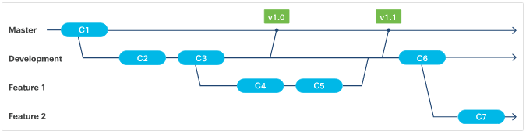
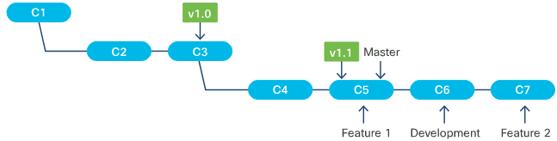
Version Control Systems What is Branching?
Branching enables users to work on code independently without affecting the main code in the repository. When a repository is created, the code is automatically put on a branch called Master.
Branches can be local or remote, and they can be deleted and have their own history, staging area, and working directory.
Git's branch creation is lightweight, and switching between branches is almost instantaneous.
When a user goes from one branch to another, the code in their working directory and the files in the staging area change accordingly, but the repository (.git) directories remain unchanged.
Notes:
3 – Software Development and Design
3.3 –Version Control Systems
3.3.4 – What is Branching?

Slide 42
Version Control Systems GitHub and Other Providers
Git and GitHub are not the same.
While Git is an implementation of distributed version control and provides a command line interface, GitHub is a service provided by Microsoft that implements a repository hosting service with Git.
In addition to providing the distributed version control and source code management functionality of Git, GitHub provides additional features such as:
code review
documentation
project management
bug tracking
feature requests
GitHub introduced the concept of the ‘pull request’, which is a way of formalizing a request by a contributor to review changes such as new code, edits to existing code, etc., in the contributor's branch for inclusion in the project's main or other curated branches.
Notes:
3 – Software Development and Design
3.3 –Version Control Systems
3.3.5 – GitHub and Other Providers

Slide 43
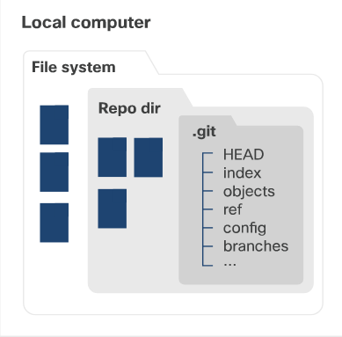
Version Control Systems Git Commands
Setting up Git
To configure Git, use the --global option to set the initial global settings.
Command: git config --global key value
Create a New Git Repository
Git provides a git init command to create an empty Git repository, or make an existing folder a Git repository.
When a new or existing project becomes a Git repository, a hidden .git directory is created in that project folder.
The .git directory is the repository that holds the metadata such as the compressed files, the commit history, and the staging area. In addition, Git also creates the master branch.
Notes:
3 – Software Development and Design
3.3 –Version Control Systems
3.3.6 – Git Commands

Slide 44
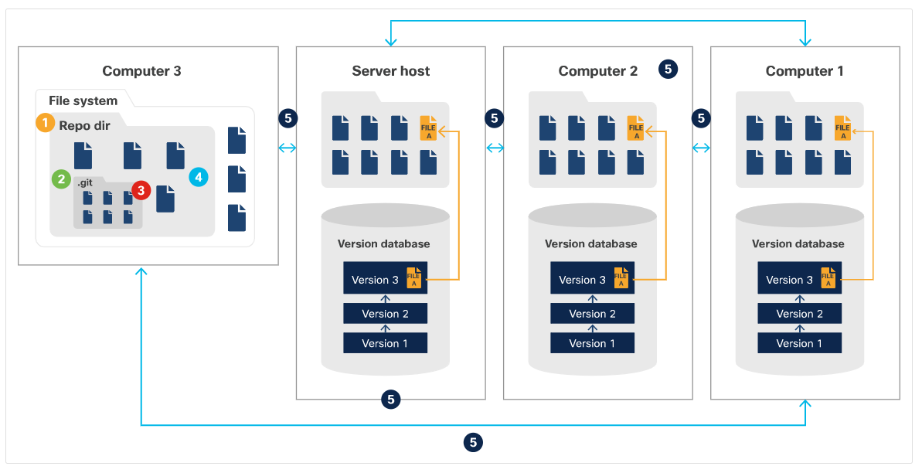
Version Control Systems Git Commands (Contd.)
Command: git init
To make a new or existing project a Git repository, use the following command:
$ git init <project directory>
where the <project directory> is the absolute or relative path to the new or existing project.
For a new Git repository, the directory in the provided path will be created first, followed by the creation of the .git directory.
Get an Existing Git Repository
Command: git clone <repository> [target directory]
where <repository> is the location of the repository to clone.
Git supports four major transport protocols for accessing the <repository>: Local, Secure Shell (SSH), Git, and HTTP.
Notes:
3 – Software Development and Design
3.3 –Version Control Systems
3.3.6 – Git Commands

Slide 45
Version Control Systems Git Commands (Contd.)
View the Modified Files in the Working Directory
Git provides a git status command to get a list of files that have differences between the working directory and the parent branch.
Command: git status
Compare Changes Between Files
Git provides a git diff command that is essentially a generic file comparison tool.
Command: git diff
When using the git diff command, the file does not need to be a Git tracked file.
Notes:
3 – Software Development and Design
3.3 –Version Control Systems
3.3.6 – Git Commands

Slide 46
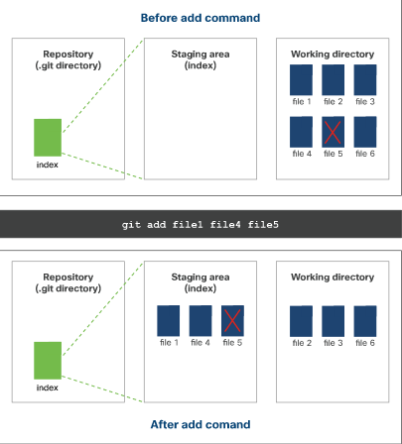
Version Control Systems Adding and Removing Files
Adding Files to the Staging Area
Command: git add
This command can be used more than once before the Git repository is updated (using commit).
Only the files specified in the git command can be added to the staging area
To add a single file to the staging area: $ git add <file path>
To add multiple files to the staging area, where the <file path> is the absolute or relative path of the file to be added to the staging area. $ git add <file path 1> ... <file path n>
To add all the changed files to the staging area: $ git add.
Notes:
3 – Software Development and Design
3.3 – Version Control Systems
3.3.7 – Adding and Removing Files

Slide 47
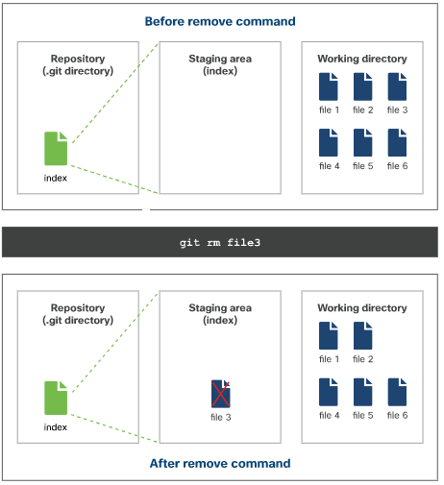
Version Control Systems Adding and Removing Files (Contd.)
Removing Files from the Git Repository
There are two ways to remove files from the Git repository.
Option 1: git rm command is used to remove files from the Git repository and add to the staging area.
Command: git rm
To remove the specified file(s) from the working directory and add the change to the staging area, use the following command: $ git rm <file path 1> ... <file path n>
where <file path> is the absolute or relative path of the file to be deleted from the Git repository.
Notes:
3 – Software Development and Design
3.3 – Version Control Systems
3.3.7 – Adding and Removing Files

Slide 48
Version Control Systems Adding and Removing Files (Contd.)
To add the specified file(s) to be removed from the staging area without removing the file(s) itself from the working directory, use the following command:
$ git rm --cached <file path 1> ... <file path n>
The git rm command will not work if the file is already in the staging area with changes.
Option 2: This option is a two-step process. First use the regular filesystem command to remove the file(s) and then add the file to the stage using the Git command.
$ rm <file path 1> ... <file path n> $ git add <file path 1> ... <file path n>
This two step process is equivalent to using the git rm <file path 1> ... <file path n> command. Using this option does not allow the file to be preserved in the working directory.
Notes:
3 – Software Development and Design
3.3 – Version Control Systems
3.3.7 – Adding and Removing Files

Slide 49
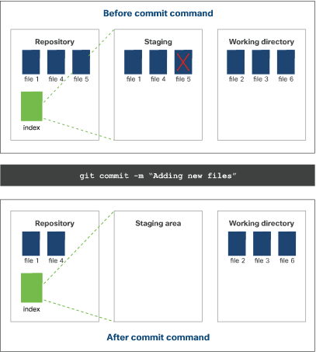
Version Control Systems Updating Repositories
Updating the Local Repository with the Changes in the Staging Area
Command: git commit
This command combines all the content changes in the staging area into a single commit and updates the local Git repository.
To commit the changes from the staging area, use the following command:
$ git commit
To commit the changes from the staging area with a message, use the following command: $ git commit -m "<message>"
Notes:
3 – Software Development and Design
3.3 – Version Control Systems
3.3.8 – Updating Repositories

Slide 50
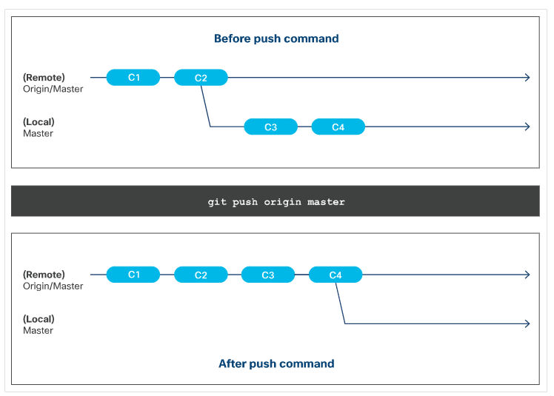
Version Control Systems Updating Repositories (Contd.)
Updating the Remote Repository
Command: git push
This command will not execute successfully if there is a conflict with adding the changes from the local Git repository to the remote Git repository.
To update the contents from the local repository to a particular branch in the remote repository, use the following command:
$ git push origin <branch name>
To update the contents from the local repository to the master branch of the remote repository, use the command: $ git push origin master
Notes:
3 – Software Development and Design
3.3 – Version Control Systems
3.3.8 – Updating Repositories

Slide 51
Version Control Systems Updating Repositories (Contd.)
Updating Your Local Copy of the Repository
Local copies of the Git repository do not automatically get updated when another contributor makes an update to the remote Git repository.
Updating the local copy of the repository is a manual step.
Command: git pull
When executing the command, the following steps occur:
The local repository ( .git directory) is updated with the latest commit, file history, and so on from the remote Git repository.
The working directory and branch is updated with the latest content from step 1.
A single commit is created on the local branch with the changes from step 1.
The working directory is updated with the latest content.
Notes:
3 – Software Development and Design
3.3 – Version Control Systems
3.3.8 – Updating Repositories

Slide 52
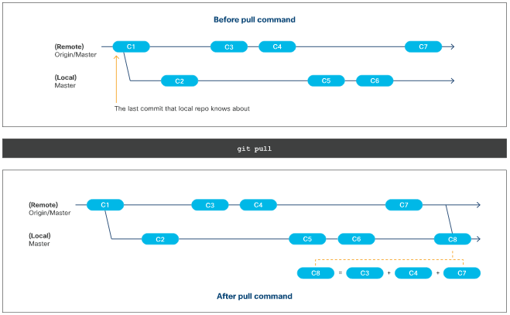
Version Control Systems Updating Repositories (Contd.)
To update the local copy of the Git repository from the parent branch, use the following command:
$ git pull
Or
$ git pull origin
To update the local copy of the Git repository from a specific branch, use the following command:
$ git pull origin <branch>
Notes:
3 – Software Development and Design
3.3 – Version Control Systems
3.3.8 – Updating Repositories

Slide 53
Version Control Systems Branching Features
Creating and Deleting a Branch
Option 1: git branch command to list, create, or delete a branch.
$ git branch <parent branch> <branch name>
Option 2: git checkout command to switch branches by updating the working directory with the contents of the branch.
$ git checkout -b <parent branch> <branch name>
Deleting a Branch
To delete a branch, use the following command:
$ git branch -d <branch name>
Get a List of all Branches
To get a list of all the local branches, use the following command:
$ git branch Or $ git branch --list
Notes:
3 – Software Development and Design
3.3 – Version Control Systems
3.3.9 – Branching Features

Slide 54
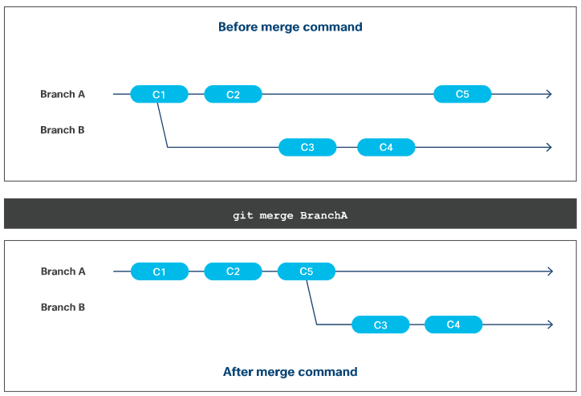
Version Control Systems Branching Features (Contd.)
Merging Branches
Branches diverge from one another when they are modified after they are created.
When Git merges the branch, it takes the changes/commits from the source branch and applies it to the target branch.
During a merge, only the target branch is modified.
The source branch is untouched and remains the same.
Notes:
3 – Software Development and Design
3.3 – Version Control Systems
3.3.9 – Branching Features

Slide 55
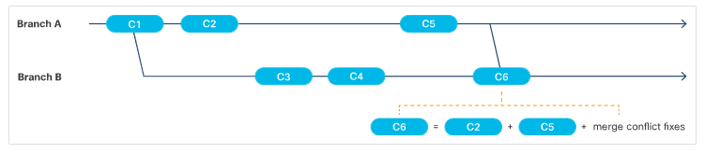
Version Control Systems Branching Features (Contd.)
Fast-Forward Merge
A fast-forward merge is when the Git algorithm is able to apply the changes/commits from the source branch(es) to the target branch automatically and without any conflicts.
Merge Conflicts
A merge conflict is when Git is not able to perform a fast-forward merge because it does not know how to automatically apply the changes from the branches together for the file(s).
Notes:
3 – Software Development and Design
3.3 – Version Control Systems
3.3.9 – Branching Features

Slide 56
Version Control Systems Branching Features (Contd.)
Performing the Merge
Git provides a git merge command to join two or more branches together.
Command: git merge
To merge a branch into the client's current branch/repository, use the below command: $ git merge <branch name>
To merge a branch into a branch that is not the client's current branch/repository, use the following command:
$ git checkout <target branch name>
$ git merge <source branch name>
To merge more than one branch into the client's current branch/repository, use the below command: $ git merge <branch name 1>...<branch name n>
Notes:
3 – Software Development and Design
3.3 – Version Control Systems
3.3.9 – Branching Features

Slide 57
Version Control Systems .diff Files
What is a .diff file?
A .diff file is used to show how two different versions of a file have changed.
By using specific symbols, this file can be read by other systems to interpret how files can be updated.
The symbols and meanings in a unified diff file are:
Symbol | Meaning
+ | Indicates that the line has been added.
- | Indicates that the line has been removed.
/dev/null | Shows that a file has been added or removed.
or "blank" | Gives context lines around changed lines.
@@ | A visual indicator that the next block of information is starting. Within the changes for one file, there may be multiple.
index | Displays the commits compared.
Notes:
3 – Software Development and Design
3.3 – Version Control Systems
3.3.10 – .diff Files

Slide 58
Version Control Systems Lab - Software Version Control with Git
In this lab, you will complete the following objectives:
Part 1: Launch the DEVASC VM
Part 2: Initializing Git
Part 3: Staging and Committing a File in the Git Repository
Part 4: Managing the File and Tracking Changes
Part 5: Branches and Merging
Part 6: Handling Merge Conflicts
Part 7: Integrating Git with GitHub
Notes:
3 – Software Development and Design
3.3 – Version Control Systems
3.3.11 – Lab - Software Version Control with Git

Slide 59
3.4 Coding Basics
Notes:
Source:
3 – Software Development and Design
3.4 – Coding Basics
In-Session Activities / Explanations:
Time: 15 mins
Instructor Notes:
Discuss the basics of coding.
Describe how methods and functions can be used to modify a code.
At the end of the topic, encourage the learners to perform Hands-on Lab.
Key Points: Python, coding, clean code

Slide 60
Coding Basics Methods, Functions, Modules, and Classes
As the project size and complexity grows, and other developers (and stakeholders) get involved, disciplined methods and best practices are needed to help developers write better code and collaborate around it more easily.
What is a clean code?
Notes:
3 – Software Development and Design
3.4 – Coding Basics
3.4.1 – Methods, Functions, Modules, and Classes

Slide 61
Coding Basics Clean Code
Clean codes are the result of developers trying to make their code easy to read and understand for other developers.
They follow some common principles related to formatting, organization, intuitiveness of components, purpose and reusability.
Clean codes emphasize on standardization, proper organization, modularity, providing inline comments and other characteristics that help make code self-documenting.
Reasons why developers want to write clean code
Clean code is easier to understand, more compact, and better-organized.
Clean code, being modular, tends to be easier to test using automated methods such as unit testing frameworks.
Clean code, being standardized, is easier to scan and check using automated tools.
It simply looks nicer.
Notes:
3 – Software Development and Design
3.4 – Coding Basics
3.4.2 – Clean Code

Slide 62
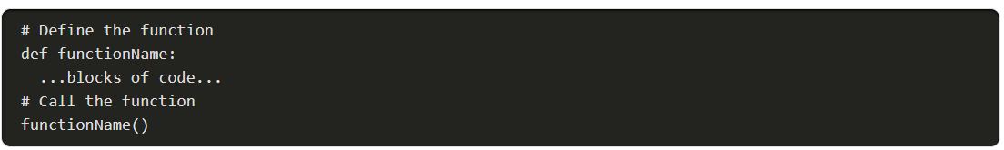
Coding Basics Methods and Functions
Methods and Functions are blocks of code that perform tasks when executed.
Following are some standard best-practices for determining whether a piece of code should be encapsulated (in a method or function):
Code that performs a discrete task, even if it happens only once, may be a candidate for encapsulation.
Task code that is used more than once should probably be encapsulated.
Methods and Functions can be written once and executed as many times as required.
If used correctly, methods and functions will simplify the code, and reduce the potential for bugs.
Syntax of a Function in Python:
Notes:
3 – Software Development and Design
3.4 – Coding Basics
3.4.3 – Methods and Functions

Slide 63
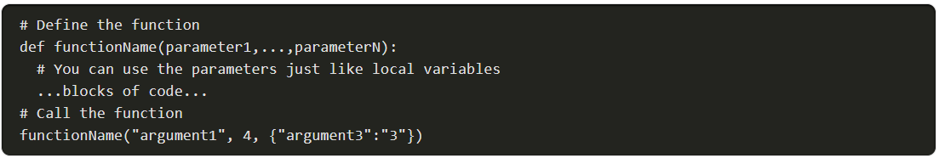
Coding Basics Methods and Functions (Contd.)
Arguments and Parameters
Arguments and parameters add flexibility to methods and functions.
Syntax of a function using arguments and parameters in Python:
Notes:
3 – Software Development and Design
3.4 – Coding Basics
3.4.3 – Methods and Functions

Slide 64
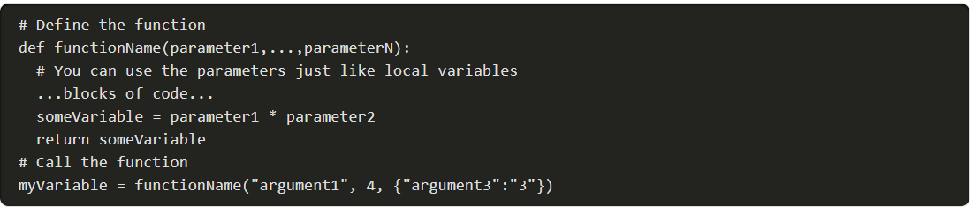
Coding Basics Methods and Functions (Contd.)
Return Statements
The return statement refers to the return value that is specified using the keyword return followed by a variable or expression. A return statement ends the execution of a function, and returns control to the calling function.
When a return statement is executed, the value of the return statement is returned and any code below it gets skipped.
Syntax of a function with a return statement in Python:
Notes:
3 – Software Development and Design
3.4 – Coding Basics
3.4.3 – Methods and Functions

Slide 65
Coding Basics Methods and Functions (Contd.)
Methods vs. Functions
Methods | Functions
Methods are code blocks associated with an object, typically for object-oriented programming. | Functions are standalone code blocks.
Notes:
3 – Software Development and Design
3.4 – Coding Basics
3.4.3 – Methods and Functions

Slide 66
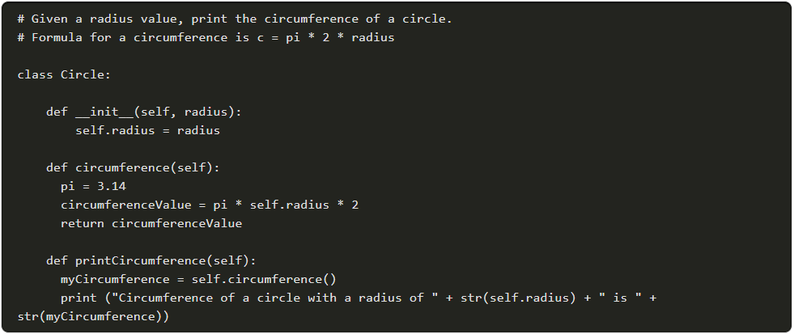
Coding Basics Modules
Developers typically use modules to divide a large project into smaller parts so that the code can be read and understood easily.
They consists of a set of functions and typically contains an interface for other modules to integrate with.
A module is packaged as a single file and is expected to work independently.
Below is a module with a set of functions saved in a script called circleClass.py.
Notes:
3 – Software Development and Design
3.4 – Coding Basics
3.4.4 – Modules

Slide 67
Coding Basics Classes
In most Object-Orient Programming (OOP) languages, and in Python, classes are a means of bundling data and functionality. Each class declaration defines a new object type.
Classes may have class variables and object variables.
New classes may be defined, based on existing, previously defined classes, so that they inherit the properties, data members, and functionality (methods).
A class may be instantiated (created) multiple times, and each with its own object-specific data attribute values.
Note: Unlike other OOP languages, in Python, there is no means of creating 'private' class variables or internal methods. However, by convention, methods and variables with a single preceding underscore ( _ ) are considered private and not to be used or referenced outside the class.
Notes:
3 – Software Development and Design
3.4 –Coding Basics
3.4.5 – Classes

Slide 68
Coding Basics Lab - Python Classes Review
In this lab, you will complete the following objectives:
Part 1: Launch the DEVASC VM
Part 2: Review Functions, Methods, and Classes
Part 3: Define a Function
Part 4: Define a Class with Methods
Part 5: Review the circleClass.py Script
Notes:
3 – Software Development and Design
3.4 – Coding Basics
3.4.6 – Lab - Python Classes Review

Slide 69
3.5 Code Review and Testing
Notes:
Source:
3 – Software Development and Design
3.5 –Code Review and Testing
In-Session Activities / Explanations:
Time: 20 mins
Instructor Notes:
Explain the importance of Code Review and Testing and discuss the ways of performing them.
Discuss the methods and tools for testing the lines of code, blocks, functions, and classes.
Explain Unit testing and Integration with the examples given in the course.
By the end of the topic, encourage the learners to perform the Hands-on Lab.
Key Points: Python, coding, unittest, Test-Driven Development

Slide 70
Code Review and Testing What is a Code Review and Why Should You Do This?
A code review is when developers look over the codebase, a subset of code, or specific code changes and provide feedback. These developers are often called reviewers.
The code review process only happens after the code changes are complete and tested.
The goal of code reviews is to make sure that the final code:
Is easy to read
Is easy to understand
Follows coding best practices
Uses correct formatting
Is free of bugs
Has proper comments and documentation
Is clean
Notes:
3 – Software Development and Design
3.5 –Code Review and Testing
3.5.1 – What is a Code Review and Why Should You Do This?

Slide 71
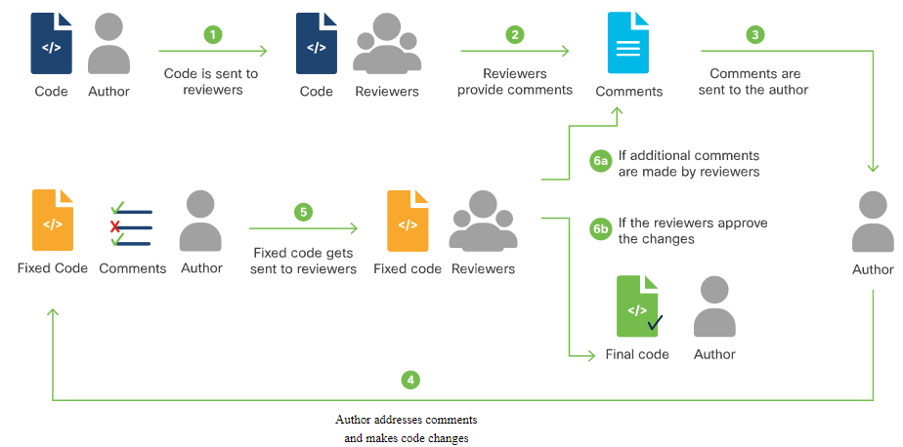
Code Review and Testing Types of Code Reviews
The most common types of code review processes include:
Formal code review: Developers have a series of meetings to review the whole codebase.
Change-based code review: Also known as a tool-assisted code review, reviews code that was changed as a result of a bug, user story, feature, commit, and so on.
Over-the-shoulder code review: A reviewer looks over the shoulder of the developer who wrote the code and provides feedback.
Email pass-around: It can occur following the automatic emails sent by the source code management systems when a checkin is made.
Notes:
3 – Software Development and Design
3.5 –Code Review and Testing
3.5.2 – Types of Code Reviews

Slide 72
Code Review and Testing Testing
Software testing is classically subdivided into two general categories:
Functional testing seeks to determine whether the software works correctly. Does it behave as intended in a logical sense, from the lowest levels of detail examined with Unit Testing, to higher levels of complexity explored in Integration Testing?
Non-functional testing examines usability, performance, security, resiliency, compliance, localization, and many other issues. This type of testing finds out if the software is fit for its purpose, provides the intended value, and minimizes risk.
Developers capture design requirements as tests and then write software to pass those tests. This is called Test-Driven Development (TDD).
Notes:
3 – Software Development and Design
3.5 – Code Review and Testing
3.5.3 – Testing

Slide 73
Code Review and Testing Unit Testing
Detailed functional testing of small pieces of code (lines, blocks, functions, classes, and other components in isolation) is called Unit Testing.
These test frameworks are software that allows you to make assertions about testable conditions and determine if these assertions are valid at a point in execution.
Examples of test frameworks for Python:
PyTest | unittest
PyTest is handy. It automatically executes any scripts that start with test_ or end with _test.py and within those scripts, automatically executes any functions beginning with 'test_' or 'tests_'. We can unit test a piece of code by copying it into a file, importing pytest, adding appropriately-named testing functions, saving the file under a filename that also begins with 'tests_,' and running it with PyTest. | The unittest framework demands a different syntax than PyTest. For unittest, you need to subclass the built-in TestCase class and test by overriding its built-in methods or adding new methods whose names begin with 'test_'.
Notes:
3 – Software Development and Design
3.5 – Code Review and Testing
3.5.4 – Unit Testing

Slide 74
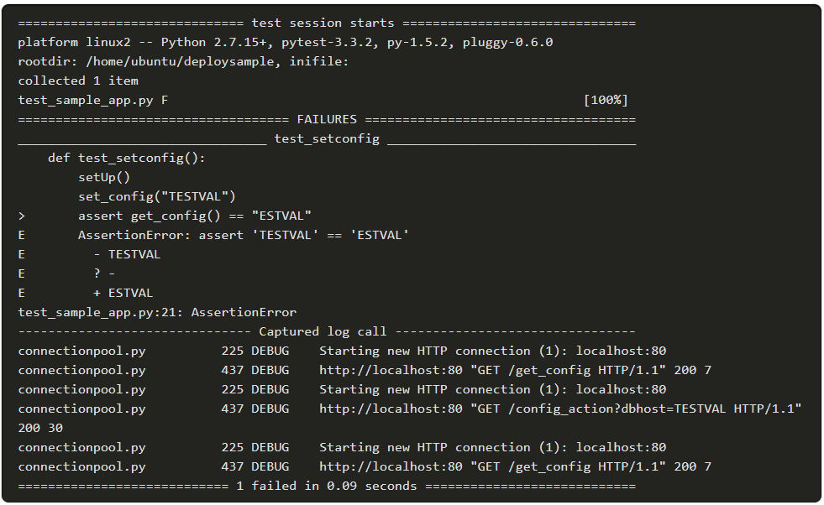
Code Review and Testing Integration Testing
Integration testing ensures that all the individual units fit together properly to make a complete application.
Running the code with PyTest produces an output as shown in the image:
Note: You can run this script on your VM using pytest. However, understanding the output and fixing any errors is beyond the scope of this course.
Notes:
3 – Software Development and Design
3.5 – Code Review and Testing
3.5.5 – Integration Testing

Slide 75
Code Review and Testing Test-Driven Development (TDD)
If you want to test to validate the application design in light of requirements, implies that you should write the testing code before you write the application code .
Having expressed the requirements in your testing code, you can then write the application code until it passes the tests that you have created in the testing code.
The basic pattern of TDD is a five-step, repeating process:
Create a new test.
Run tests to see if any fail for unexpected reasons.
Write application code to pass the new test.
Run tests to see if any fail.
Refactor and improve application code.
Notes:
3 – Software Development and Design
3.5 – Code Review and Testing
3.5.6 – Test-Driven Development (TDD)

Slide 76
Code Review and Testing Lab - Create a Python Unit Test
In this lab, you will complete the following objectives:
Part 1: Launch the DEVASC VM
Part 2: Explore Options in the unittest Framework
Part 3: Test a Python Function with unittest
Notes:
3 – Software Development and Design
3.5 – Code Review and Testing
3.5.7 – Lab - Create a Python Unit Test

Slide 77
3.6 Understanding Data Formats
Notes:
Source:
3 – Software Development and Design
3.6 – Understanding Data Formats
In-Session Activities / Explanations:
Time: 20 mins
Instructor Notes:
Introduce Data Formats to the learners.
Explain remote APIs such as XML, JSON, and YAML with examples given in the module.
By the end of the topic, encourage the learners to perform Hands-on Lab.
Key Points: XML, JSON, YAML, Parsing

Slide 78
Understanding Data Formats Data Formats
Rest APIs let you exchange information with remote services and equipment.
The three most popular standard formats for exchanging information with remote APIs are XML, JSON, and YAML.
Parsing XML, JSON, or YAML is a frequent requirement of interacting with APIs. An oft-encountered pattern in REST API implementations is as follows:
Authenticate, usually by POSTing a user/password combination and retrieving an expiring token for use in authenticating subsequent requests.
Execute a GET request to a given endpoint (authenticating as required) to retrieve the state of a resource, requesting XML, JSON, or YAML as the output format.
Modify the returned XML, JSON, or YAML.
Execute a POST (or PUT) to the same endpoint (again, authenticating as required) to change the state of the resource, again requesting XML, JSON, or YAML as the output format and interpreting it as needed to determine if the operation was successful.
Notes:
3 – Software Development and Design
3.6 – Understanding Data Formats
3.6.1 – Data Formats

Slide 79
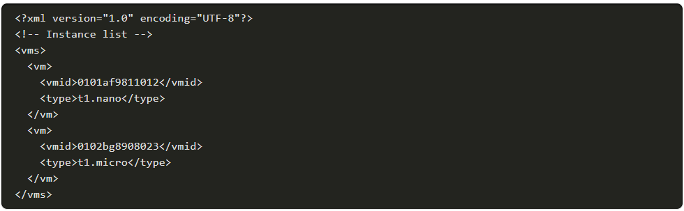
Understanding Data Formats XML
Extensible Markup Language (XML) is a generic methodology for wrapping textual data in symmetrical tags to indicate semantics.
It is a derivative of Structured, Generalized Markup Language (SGML), and also the parent of HyperText Markup Language (HTML). XML filenames typically end in ".xml".
An Example XML Document
Notes:
3 – Software Development and Design
3.6 – Understanding Data Formats
3.6.2 – XML

Slide 80
Understanding Data Formats XML (Contd.)
XML Document Body: Except the first two lines of a XML document, the remainder of the document is considered as the body.
User-Defined Tag Names: XML tag names are user-defined. If you are composing XML for your own application, pick tag names that clearly express the meaning of data elements, their relationships, and hierarchy.
Special Character Encoding: Data is conveyed in XML as readable text.
XML Prologue: The XML prologue is the first line in an XML file.
Comments in XML: XML files can include comments, using the same commenting convention used in HTML documents.
XML Attributes: XML lets you embed attributes within tags to convey additional information.
Notes:
3 – Software Development and Design
3.6 – Understanding Data Formats
3.6.2 – XML

Slide 81
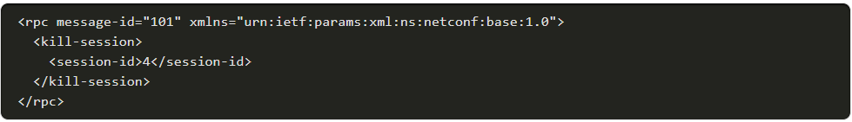
Understanding Data Formats XML (Contd.)
XML Namespaces:
Namespaces are defined by the IETF and other internet authorities, organizations, and other entities, and their schemas are typically hosted as public documents on the web.
Namespaces are identified by Uniform Resource Names (URIs) to make persistent documents reachable without the seeker needing to be concerned about their location.
The code example below shows the use of a namespace, defined as the value of an xmlns attribute, to assert that the content of an XML remote procedure call should be interpreted according to the legacy NETCONF 1.0 standard.
Notes:
3 – Software Development and Design
3.6 – Understanding Data Formats
3.6.2 – XML

Slide 82
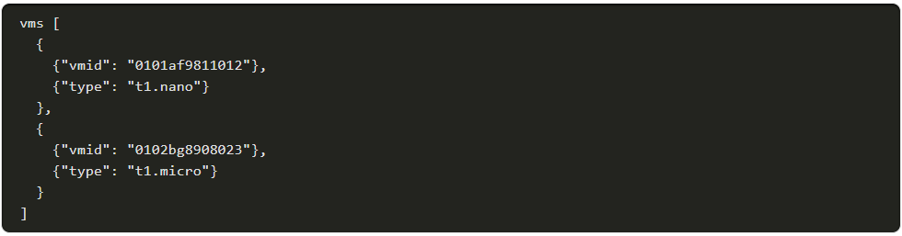
Understanding Data Formats XML (Contd.)
Interpreting XML
In the XML Namespaces example, the structure is represented as a list or one-dimensional array (called 'instances') of objects (each identified as an 'instance' by bracketing tags). Each instance object contains two key-value pairs denoting a unique instance ID and VM server type.
A semantically-equivalent Python data structure might be declared as shown below:
Notes:
3 – Software Development and Design
3.6 – Understanding Data Formats
3.6.2 – XML

Slide 83
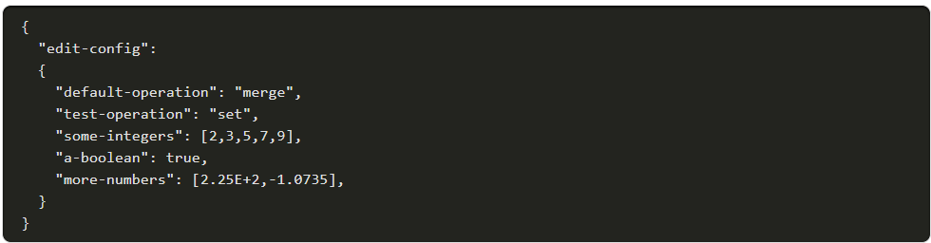
Understanding Data Formats JSON
JSON, or JavaScript Object Notation, is a data format derived from the way complex object literals are written in JavaScript.
JSON filenames typically end in “.json.”
Below is a sample JSON file, containing two values that are text strings, one is a boolean value, and two are arrays:
Notes:
3 – Software Development and Design
3.6 – Understanding Data Formats
3.6.3 – JSON

Slide 84
Understanding Data Formats JSON (Contd.)
JSON Basic Data Types: JSON basic data types include numbers, strings, Booleans, or nulls.
JSON Objects: As in JavaScript, individual objects in JSON comprise of key/value pairs, which may be surrounded by braces, individually.
JSON Maps and Lists: In this case, each individual key/value pair does not need its own set of brackets, but the entire object does. JSON compound objects can be deeply-nested, with complex structure. It can also express JavaScript ordered arrays (or 'lists') of data or objects.
No Comments in JSON: Unlike XML and YAML, JSON does not support any kind of standard method for including unparsed comments in code.
Whitespace Insignificant: Whitespace in JSON is not significant, and files can be indented using tabs or spaces as preferred, or not at all.
Notes:
3 – Software Development and Design
3.6 – Understanding Data Formats
3.6.3 – JSON

Slide 85
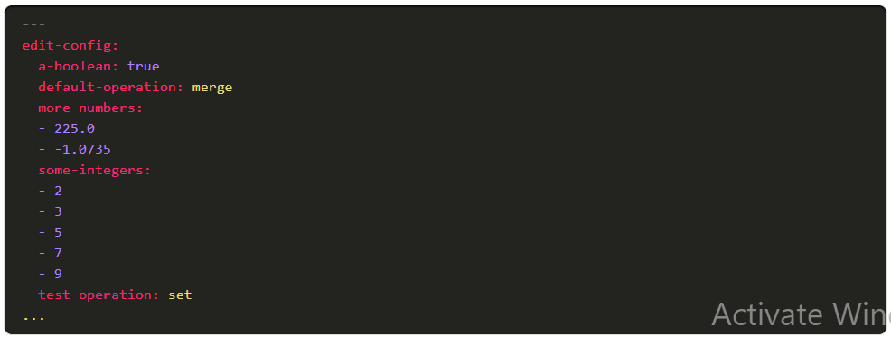
Understanding Data Formats YAML
YAML Ain't Markup Language (YAML) is a superset of JSON designed for even easier human readability.
As a superset of JSON, YAML parsers can generally parse JSON documents (but not vice-versa).
Hence, YAML is better than JSON at certain tasks, including the ability to embed JSON directly (including quotes) in YAML files.
Notes:
3 – Software Development and Design
3.6 –Understanding Data Formats
3.6.4 – YAML

Slide 86

Understanding Data Formats YAML (Contd.)
YAML File Structure: YAML files conventionally open with three dashes ( --- alone on a line) and end with three dots ( ... likewise).
YAML Data Types: YAML basic data types include numbers, strings, Booleans, or nulls.
Basic Objects: In YAML, basic data types are equated to keys.
YAML Indentation and File Structure: YAML indicates its hierarchy using indentation.
Maps and Lists: YAML easily represents more complex data types, such as maps containing multiple key/value pairs and ordered lists.
Maps are generally expressed over multiple lines, beginning with a label key and a colon, followed by members, indented on subsequent lines:
Notes:
3 – Software Development and Design
3.6 – Understanding Data Formats
3.6.4 – YAML

Slide 87
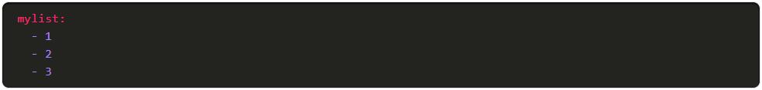
Understanding Data Formats YAML (Contd.)
Lists (arrays) are represented with optionally-indented members preceded by a single dash and space:
Maps and lists can also be represented in a so-called "flow syntax," which looks very much like JavaScript or Python:
Notes:
3 – Software Development and Design
3.6 – Understanding Data Formats
3.6.4 – YAML

Slide 88
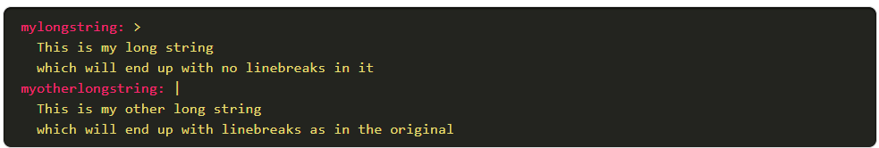
Understanding Data Formats YAML (Contd.)
Long Strings: They are represented using a 'folding' syntax, where linebreaks are presumed to be replaced by spaces when the file is parsed/consumed, or in a non-folding syntax.
Notes:
3 – Software Development and Design
3.6 – Understanding Data Formats
3.6.4 – YAML

Slide 89
Understanding Data Formats YAML (Contd.)
Comments: Comments in YAML can be inserted anywhere except in a long string literal, and are preceded by the hash sign and a space.
More YAML Features: YAML has many more features, most often encountered when using it in the context of specific languages, like Python, or when converting to JSON or other formats. For example, YAML 1.2 supports schemas and tags, which can be used to disambiguate interpretation of values.
For example, to force a number to be interpreted as a string, you could use the !!str string, which is part of the YAML "Failsafe" schema:
Notes:
3 – Software Development and Design
3.6 – Understanding Data Formats
3.6.4 – YAML

Slide 90
Understanding Data Formats Parsing and Serializing
Parsing means analyzing a message, breaking it into its component parts, and understanding their purposes in context.
Serializing is roughly the opposite of parsing.
Popular programming languages such as Python generally incorporate easy-to-use parsing functions that can accept data returned by an I/O function and produce a semantically-equivalent internal data structure containing valid typed data.
On the outbound side, they contain serializers that turn internal data structures into semantically-equivalent messages formatted as character strings.
Notes:
3 – Software Development and Design
3.6 – Understanding Data Formats
3.6.5 – Parsing and Serializing

Slide 91
Understanding Data Formats Lab - Parse Different Data Types with Python
In this lab, you will complete the following objectives:
Part 1: Launch the DEVASC VM
Part 2: Parse XML in Python
Part 3: Parse JSON in Python
Part 4: Parse YAML in Python
Notes:
3 – Software Development and Design
3.6 – Understanding Data Formats
3.6.6 – Lab - Parse Different Data Types with Python

Slide 92
3.7 Software Development and Design Summary
Notes:
Source:
3 – Software Development and Design
3.7 – Software Development and Design Summary
In-Session Activities / Explanations:
Time: 5 min
Instructor Notes:
Summarise the main points of the module and take the learners through the new terms that they have learned in this module.
Ask them to complete the module quiz present in section 3.7.2.
Key Points: NA

Slide 93
Software Development and Design Summary What Did I Learn in this Module?
Six phases of SDLC: Requirements & Analysis, Design, Implementation, Testing, Deployment and Maintenance.
Three popular software development models are Waterfall, Agile, and Lean.
The MVC design pattern simplifies development of applications that depend on graphic user interfaces.
Version control maintains history of changes to a file. Types of version control systems: Local, Centralized, and Distributed.
Git is an open source implementation of a distributed version control system and has two types of repositories: local and remote.
Clean code is the result of developers trying to make their code easy to read and understand for other developers.
Code review involves reviewing a codebase, a subset of code, or specific code change to provide feedback.
Three most popular standard formats for exchanging information with remote APIs: XML, JSON and YAML.
Parsing requires analyzing a message, breaking it into its component parts, and understanding their purposes in context. Serializing is roughly the opposite.
.
Notes:
3 – Software Development and Design
3.7 – Software Development and Design Summary
3.7.1 – What Did I Learn in this Module?
3.7.2 - Module 3: Software Development and Design Quiz

Slide 94
Software Development and Design New Terms and Commands
Software Development Life Cycle (SDLC) User experience (UX) Software Requirement Specification (SRS) Agile Scrum Lean Extreme Programming (XP) Feature-Driven Development (FDD) Sprints Backlog User stories Scrum Teams Model-View-Controller (MVC) | Centralized Version Control Systems (CVCS) Distributed Version Control System (DVCS) Git Branching GitHub Arguments Parameters Object-Orient Programming (OOP) Formal Code Review Change-Based Code Review Over-the-Shoulder Code Review | Test-Driven Development (TDD) Unit Testing Software Development Kits (SDKs) XML JSON YAML Application Programming Interfaces (APIs) REpresentational State Transfer (REST) Long Strings Parsing Serializing
Notes:
3 – Software Development and Design
New Terms and Commands

